Slide 1
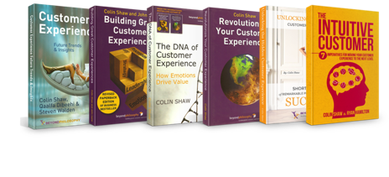
7 Key Strategic Questions Critical to Improve your Customer Experience
Presented by
Colin Shaw, Founder and CEO

Slide 2
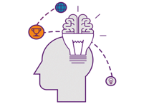
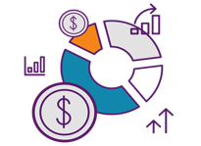
Beyond Philosophy & how we work…
WE ARE PRACTICAL THOUGHT LEADERS
OUR EXPERIENCE IN CUSTOMER EXPERIENCE IS VAST
We take a scientific approach; we don’t just look at the rational experience but also what drives human behavior - emotions, subconscious, behavioral economics and psychology, and then mix this with a practical implementation. Thought leadership with real world results. Hence our name ‘Beyond Philosophy’
We are the first operational CX consultancy and training company in the world. Since 2002, we have had the pleasure to serve many of the top organizations across the globe.
WE ACT AS YOUR GUIDE AND PARTNER
WE FOCUS ON WHAT WILL DRIVE VALUE ($) FOR YOU
We’ll help you develop the strategy, guide the initiatives, and even train your CX team on our tools & methodologies. We do not wish to embed ourselves or be ‘camped out’ in your organization.
We do not believe in ‘exceeding Customer expectations’ at every point of contact. We do believe in identifying and focusing on those aspects of your experience that will drive the most value for you. To help achieve this we have the world’s largest database of what drives Customer emotions.
WE REDUCE RISK AND INCREASE PERFORMANCE
SEASONED CUSTOMER EXPERIENCE TOOLS & METHODS
We have a variety of proven tools and techniques to apply to your unique situation. We build a program around what will get you the best results. Through our vast experience we know what works and what doesn’t.
With our vast experience we know what works and what doesn’t. We have evolved our tool set in practical implementation and these are proven to work. We can use these on our engagement or we can train your people on how to do this or a mix of both.

Slide 3
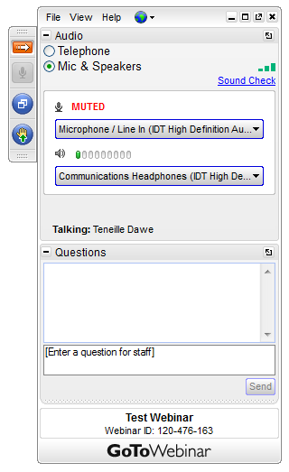

Slide 4
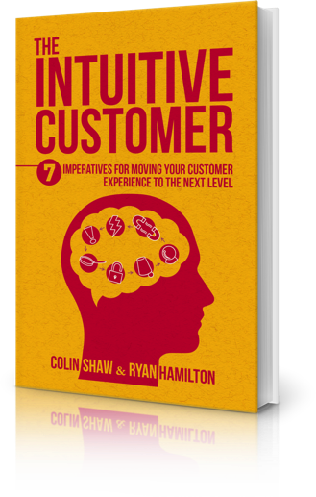
Behavioural Economics
Psychology
Subconscious
Emotions
Rational Action

Slide 5
7 Key Strategic Questions Critical to improve your Customer Experience
What is the Customer Experience you are trying to deliver?
What are the emotions you are trying to evoke?
What do Customers really want and what drives & destroys value?
What is your subconscious experience?
How well do embrace Customer irrationality?
Is your Customer Experience deliberate?
How Customer centric is your organization?

Slide 6
7 Key Strategic Questions Critical to improve your Customer Experience
What is the Customer Experience you are trying to deliver?

Slide 7
Maersk Line Customer Experience Statement
- our goal for every customer experience
Trust Be honest, set realistic expectations, follow-up on your commitments
Cared For Know your customer, be proactive, be adaptable
Pleased Take ownership, show enthusiasm, do a little bit extra
Notes:
7
There are a number of key strategic questions that lead us in to our emotional values:
What is the customer experience we would like to deliver?
What are the emotions we want to evoke?
What do our customers really want?
How can we deliver a deliberate customer experience?
As a guideline for the organization to answer these questions, LMB stated that the goal for Maersk Line is to provide a customer experience that makes customers feel Pleased, Cared For, and Trust.
This is called Maersk’s Customer Experience Statement. These three emotional values describe what we want our customers to experience when being in contact with us. This is Our Goal for Every Customer Experience.
Implementing these goals in an organization of Maersk’s size, requires a lot of commitment and focus. This is why we have decided upon an implementation plan driven by Customer Experience Ambassadors in each local site.

Slide 8
7 Key Strategic Questions Critical to improve your Customer Experience
What is the Customer Experience you are trying to deliver?
What are the emotions you are trying to evoke?

Slide 9
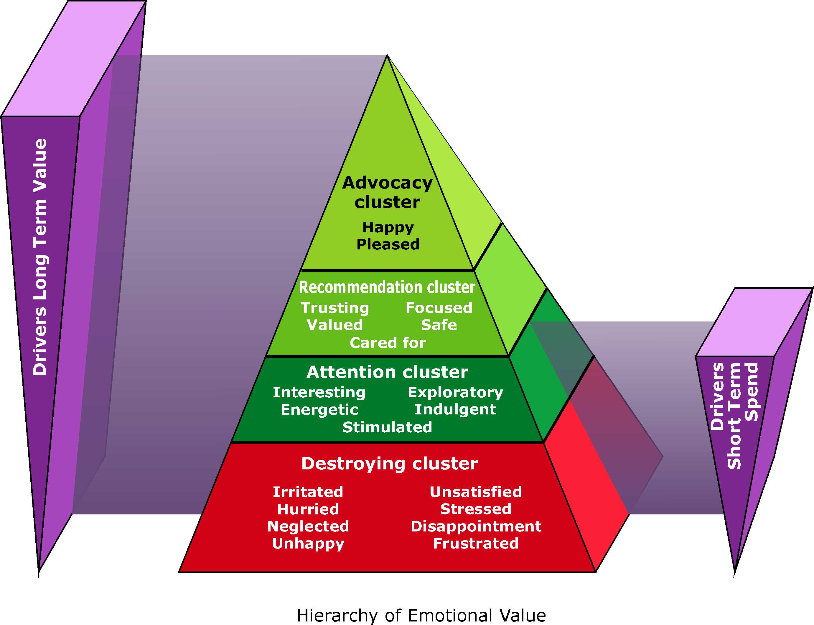
Beyond Philosophy © All rights reserved. 2001-2015

Slide 10
7 Key Strategic Questions Critical to improve your Customer Experience
What is the Customer Experience you are trying to deliver?
What are the emotions you are trying to evoke?
What do Customers really want and what drives & destroys value?

Slide 11
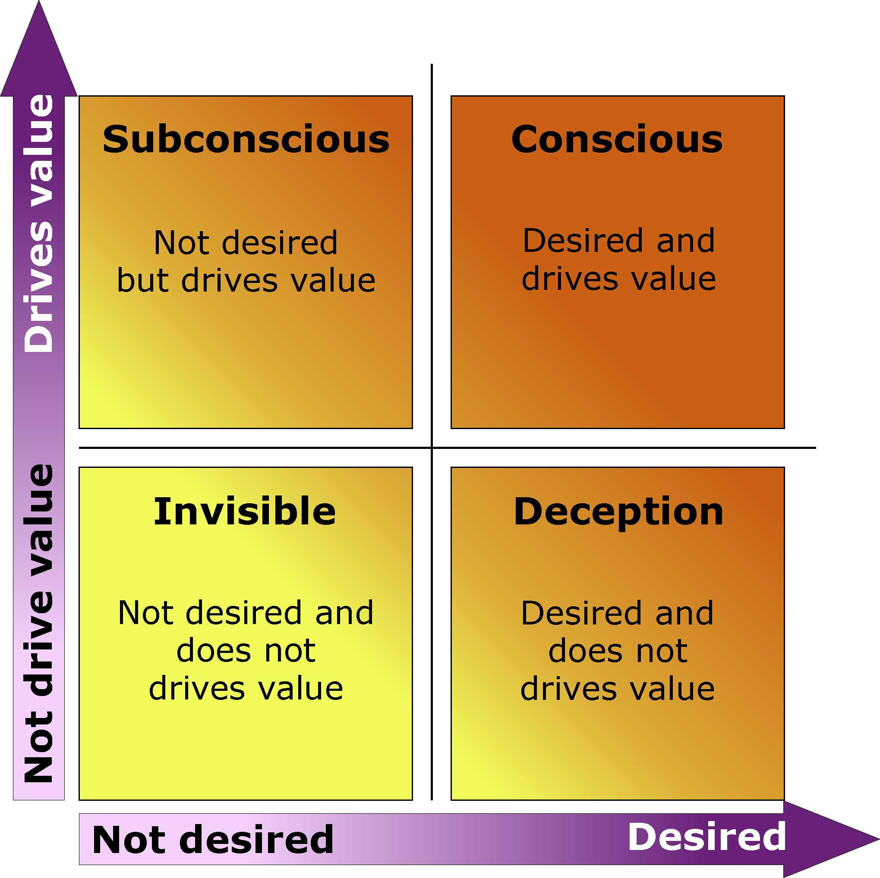
Beyond Philosophy © All rights reserved. 2001-2015

Slide 12
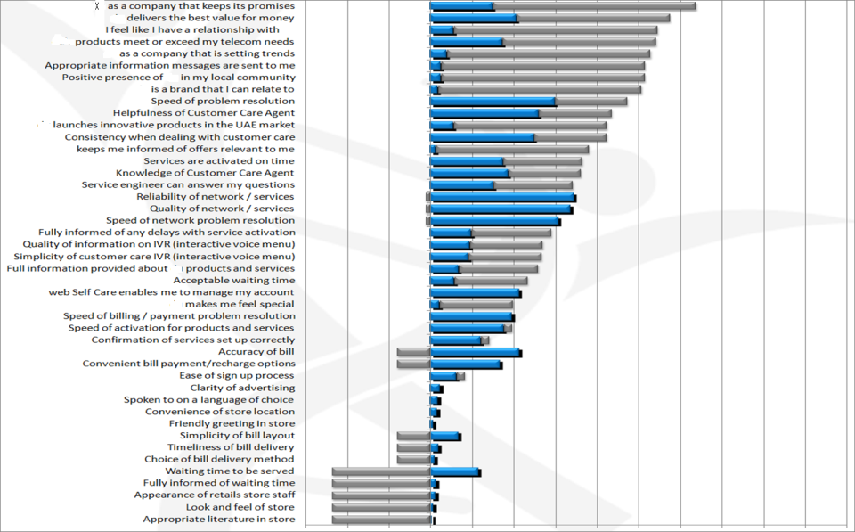
Mobile Phone Company
Desired by Customer
Effect on Value
Subconscious Attribute: has a big impact on business value even though customers do not state that it is a desirable attribute.
Top Ten
Conscious Attribute: has a great impact on business value and is consciously desired by customers
Deceptive Attribute: is consciously desired by customers and yet has little impact on value to the business
Invisible Attribute: neither is desired by customers nor drives value for the business
-
Relative Magnitude
+
0
Beyond Philosophy © All rights reserved. 2001-2015

Slide 13
7 Key Strategic Questions Critical to improve your Customer Experience
What is the Customer Experience you are trying to deliver?
What are the emotions you are trying to evoke?
What do Customers really want and what drives & destroys value?
What is your subconscious experience?

Slide 15
7 Key Strategic Questions Critical to improve your Customer Experience
What is the Customer Experience you are trying to deliver?
What are the emotions you are trying to evoke?
What do Customers really want and what drives & destroys value?
What is your subconscious experience?
How well do embrace Customer irrationality?

Slide 16
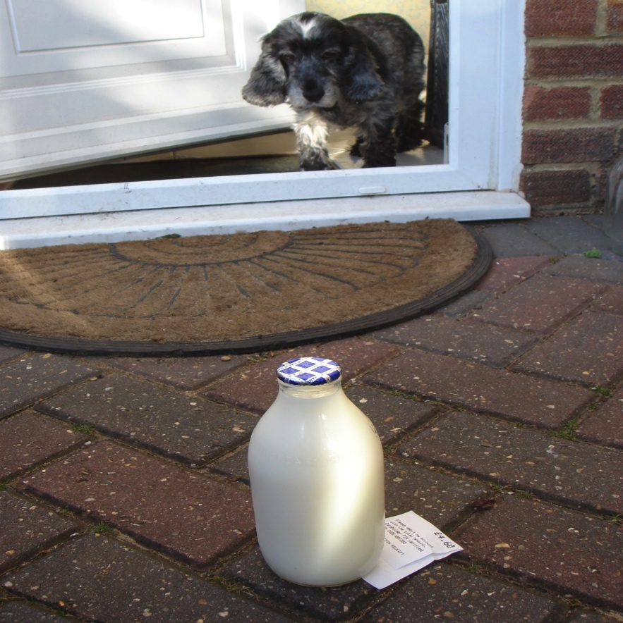

Slide 17
7 Key Strategic Questions Critical to improve your Customer Experience
What is the Customer Experience you are trying to deliver?
What are the emotions you are trying to evoke?
What do Customers really want and what drives & destroys value?
What is your subconscious experience?
How well do embrace Customer irrationality?
Is your Customer Experience deliberate?

Slide 18
Experiencing self
Remembering self
Source: Professor Daniel Kahneman

Slide 19
7 Key Strategic Questions Critical to improve your Customer Experience
What is the Customer Experience you are trying to deliver?
What are the emotions you are trying to evoke?
What do Customers really want and what drives & destroys value?
What is your subconscious experience?
How well do embrace Customer irrationality?
Is your Customer Experience deliberate?
How Customer centric is your organization?

Slide 20
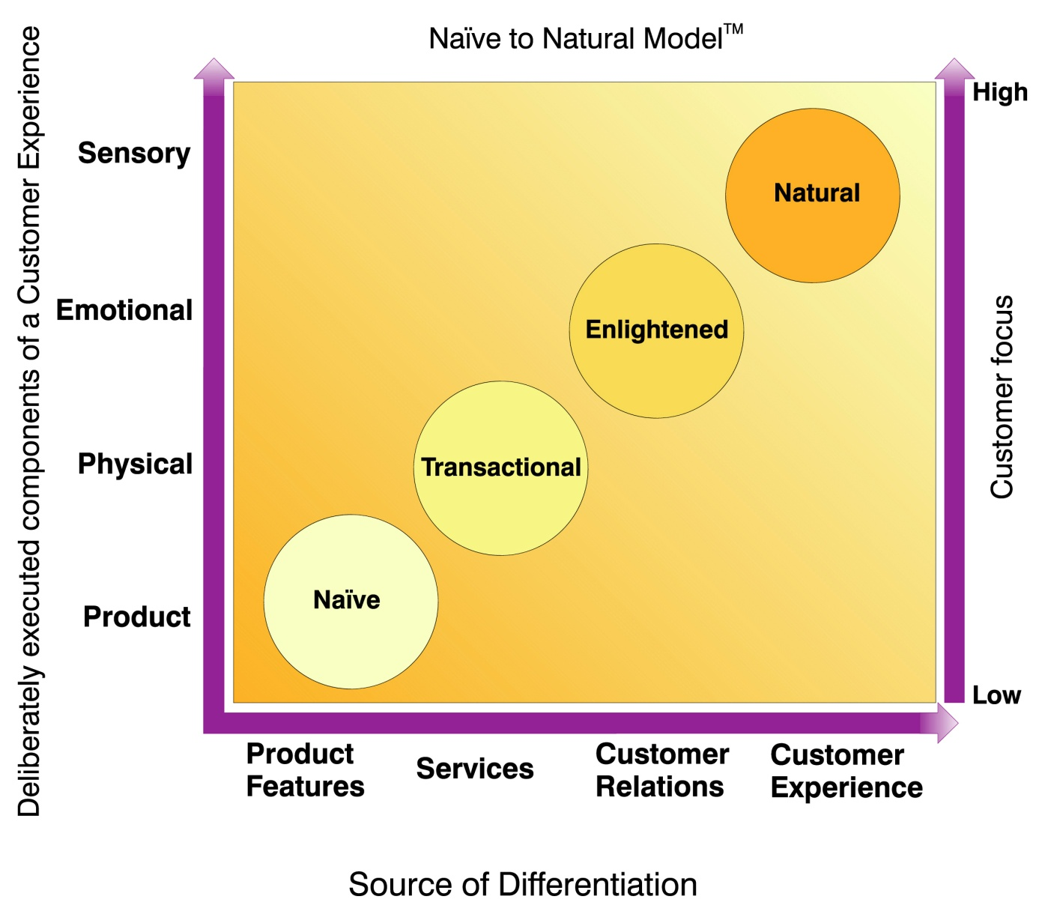
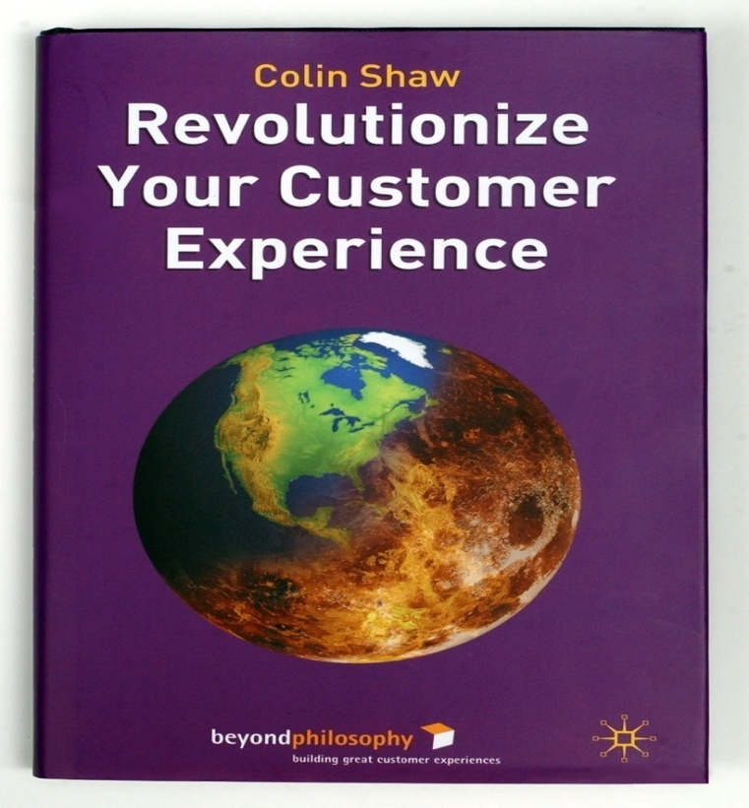
Beyond Philosophy © All rights reserved. 2001-2015

Slide 21
Q&A time – Send us your questions

Slide 22
Upcoming webinars…
Customers are irrational: Don’t fight it, embrace it!
Thursday, October 19th 2017
Intuitive Customer conversation
Every other Monday

Slide 23
Your feedback please!
When you exit…

